Slide 1
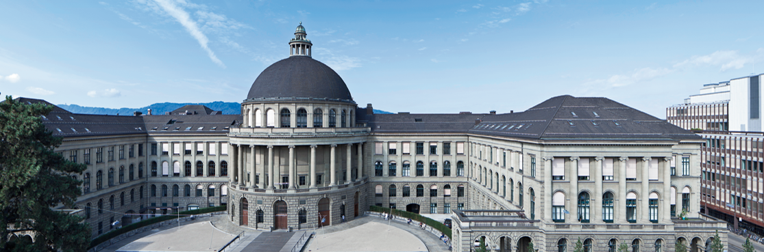
Efficiently Learning Fourier-Sparse Set Functions
Andisheh Amrollahi¹, Amir Zandieh^{2 ,} Andreas Krause¹, and Mikhail Kapralov²
¹: ETH Zurich
²: EPFL

Slide 2
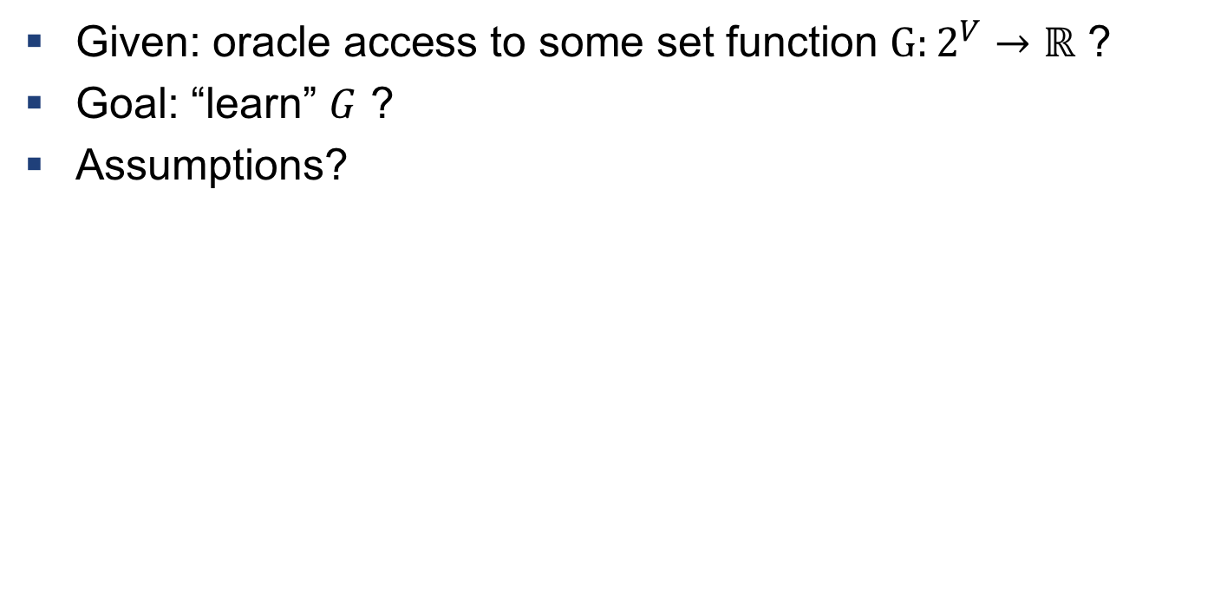
Motivation
Given: oracle access to some set function $G:2^{V}→ℝ$ ?
Goal: “learn” $G$ ?
Assumptions?
Sparsity in the Fourier domain

Slide 3
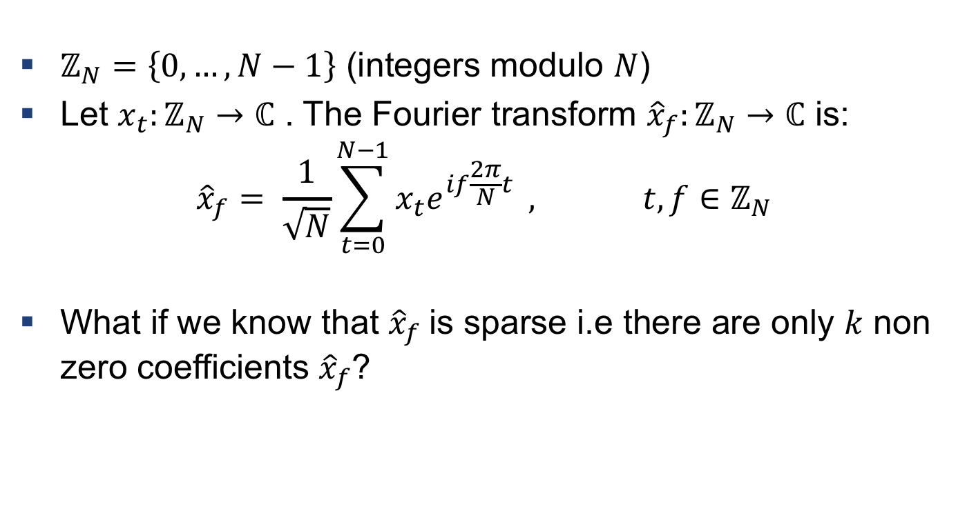
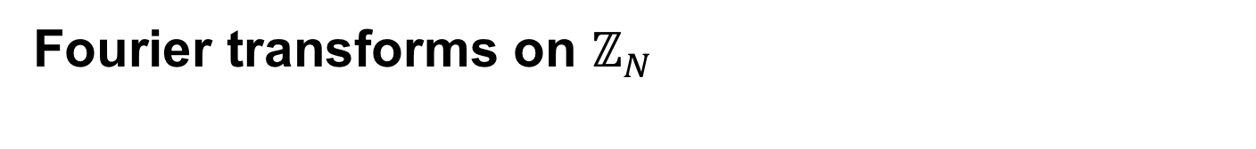
Fourier transforms on $ℤ_{N}$
$ℤ_{N}=\left\{0, …, N−1\right\}$ (integers modulo $N$)
Let $x_{t}:ℤ_{N}→ℂ$ . The Fourier transform ${\hat{x}}_{f}:ℤ_{N}→ℂ$ is:
$${\hat{x}}_{f}= \frac{1}{\sqrt{N}}\sum_{t=0}^{N−1}{x_{t}e^{if\frac{2π}{N}t}} , t,f∈ℤ_{N}$$
What if we know that ${\hat{x}}_{f}$is sparse i.e there are only $k$ non zero coefficients ${\hat{x}}_{f}$?

Slide 4
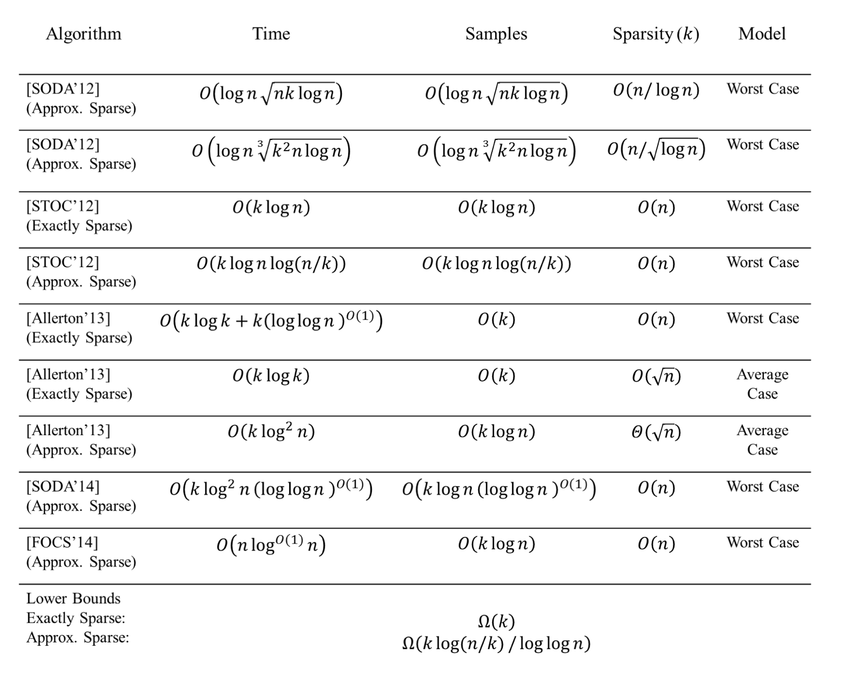
Computational and sampling complexities of the sparse Fourier transform

Slide 5
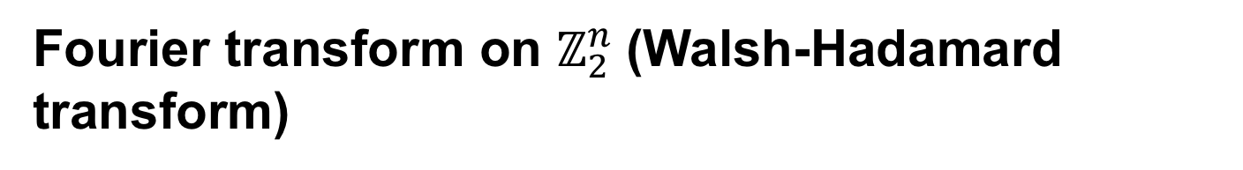
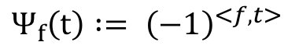
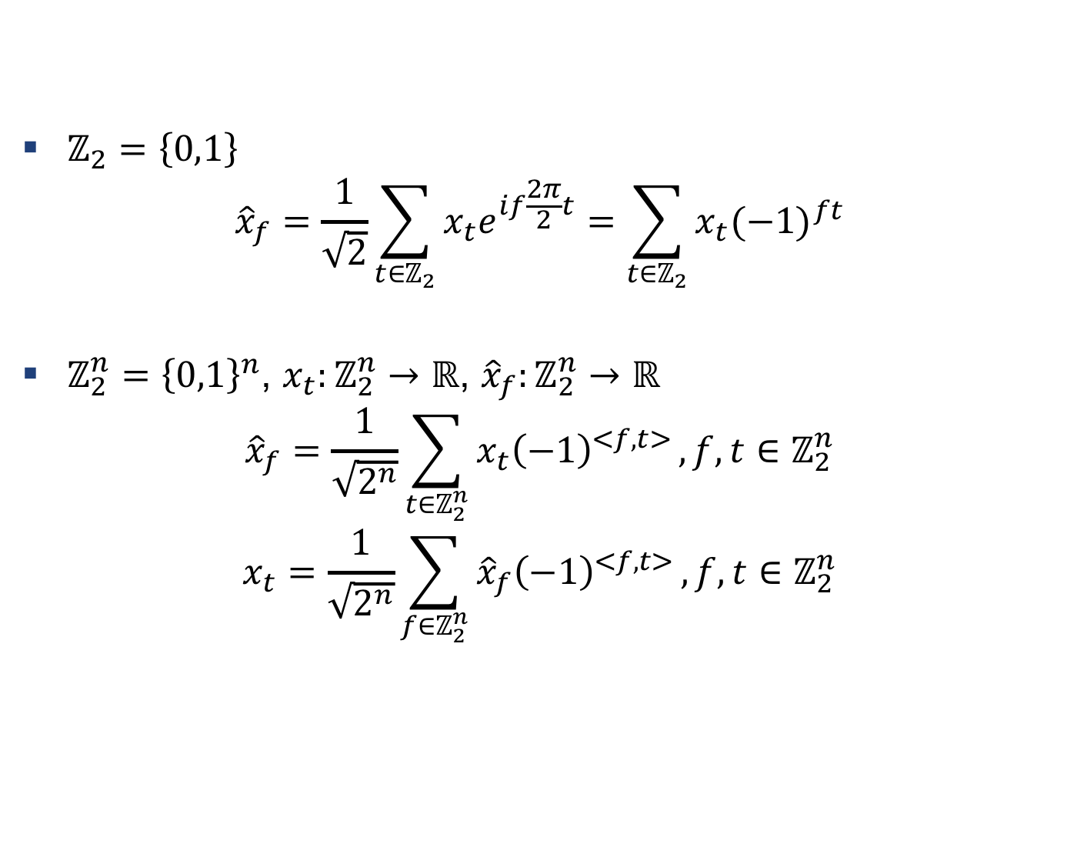
Fourier transform on $ℤ_{2}^{n}$(Walsh-Hadamard transform)
$ℤ_{2}=\left\{0,1\right\}$
$${\hat{x}}_{f}=\frac{1}{\sqrt{2}}\sum_{t∈ℤ_{2}}{x_{t}e^{if\frac{2π}{2}t}}=\sum_{t∈ℤ_{2}}{x_{t}{(−1)}^{ft}}$$
$ℤ_{2}^{n}={\left\{0,1\right\}}^{n}$, $x_{t}:ℤ_{2}^{n}→ℝ$, ${\hat{x}}_{f}:ℤ_{2}^{n}→ℝ$
$${\hat{x}}_{f}=\frac{1}{\sqrt{2^{n}}}\sum_{t∈ℤ_{2}^{n}}{x_{t}{\left(−1\right)}^{<f,t>}},f,t∈ℤ_{2}^{n}$$
$$x_{t}=\frac{1}{\sqrt{2^{n}}}\sum_{f∈ℤ_{2}^{n}}{{\hat{x}}_{f}{\left(−1\right)}^{<f,t>}},f,t∈ℤ_{2}^{n}$$
$$Ψ_{f}\left(t\right) := {\left(−1\right)}^{<f,t>}$$

Slide 6
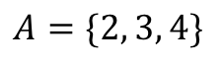
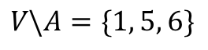
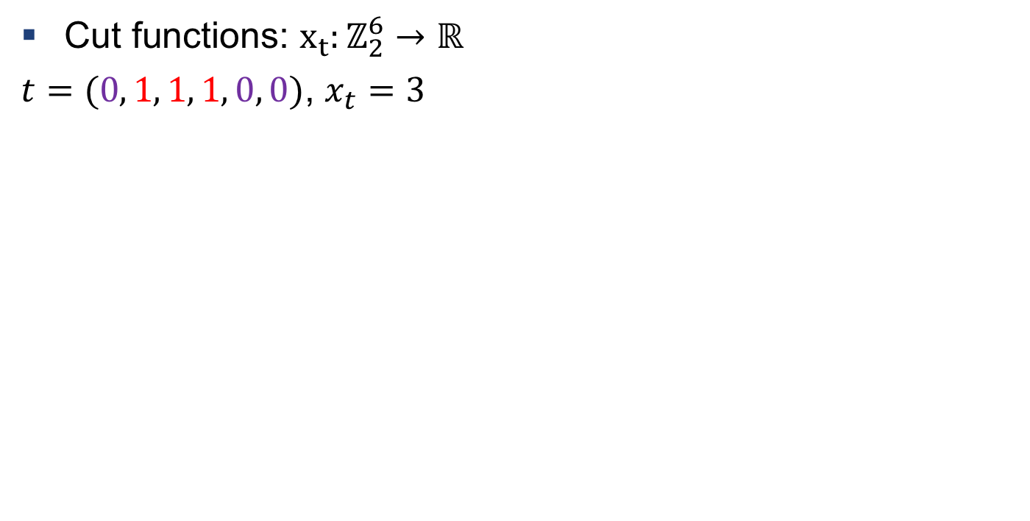
Examples: Cut functions
Cut functions: $x_{t}:ℤ_{2}^{6}→ℝ$
$t=(0, 1, 1, 1, 0, 0)$, $x_{t}=3$
2
1
5
3
6
4
$$A=\{2, 3, 4\}$$
$$V\backslash A=\{1, 5, 6\}$$

Slide 7
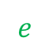
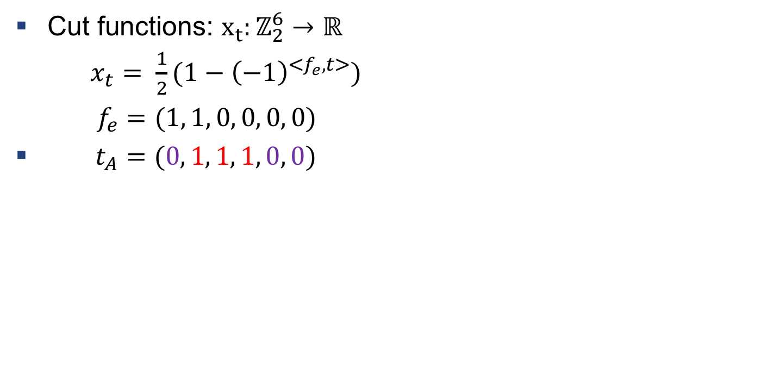
Examples: Cut functions
Cut functions: $x_{t}:ℤ_{2}^{6}→ℝ$
$x_{t}= \frac{1}{2}(1−{\left(−1\right)}^{<f_{e},t>})$
$f_{e}=(1, 1, 0, 0, 0, 0)$
$t_{A}=(0, 1, 1, 1, 0, 0)$
$$e$$
2
1
5
3
6
4
$$A=\{2, 3, 4\}$$
$$V\backslash A=\{1, 5, 6\}$$

Slide 8
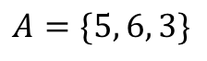
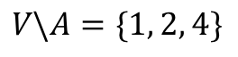
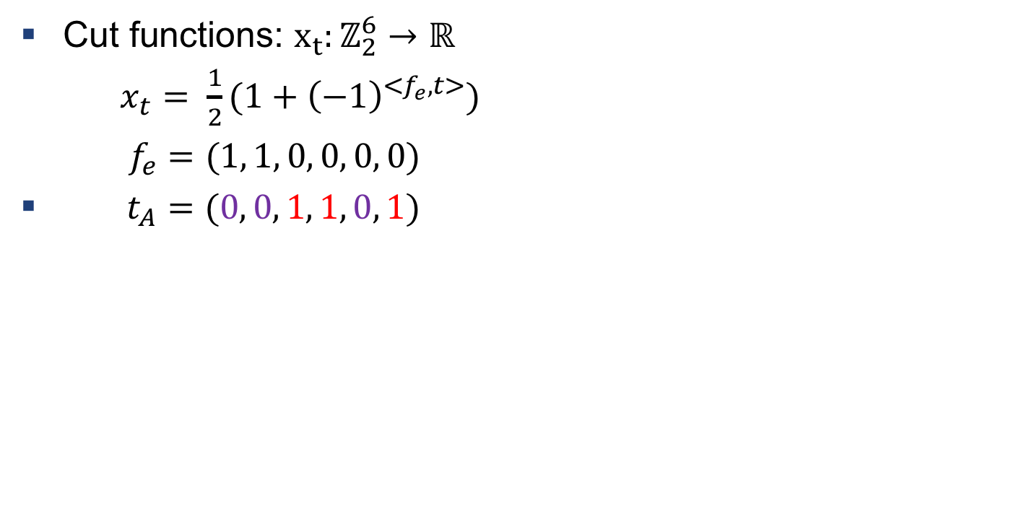
Examples: Cut functions
Cut functions: $x_{t}:ℤ_{2}^{6}→ℝ$
$x_{t}= \frac{1}{2}(1+{\left(−1\right)}^{<f_{e},t>})$
$f_{e}=(1, 1, 0, 0, 0, 0)$
$t_{A}=(0, 0, 1, 1, 0, 1)$
1
5
$$e$$
6
2
3
4
$$A=\{5, 6, 3\}$$
$$V\backslash A=\{1, 2, 4\}$$

Slide 9
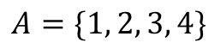
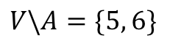
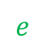
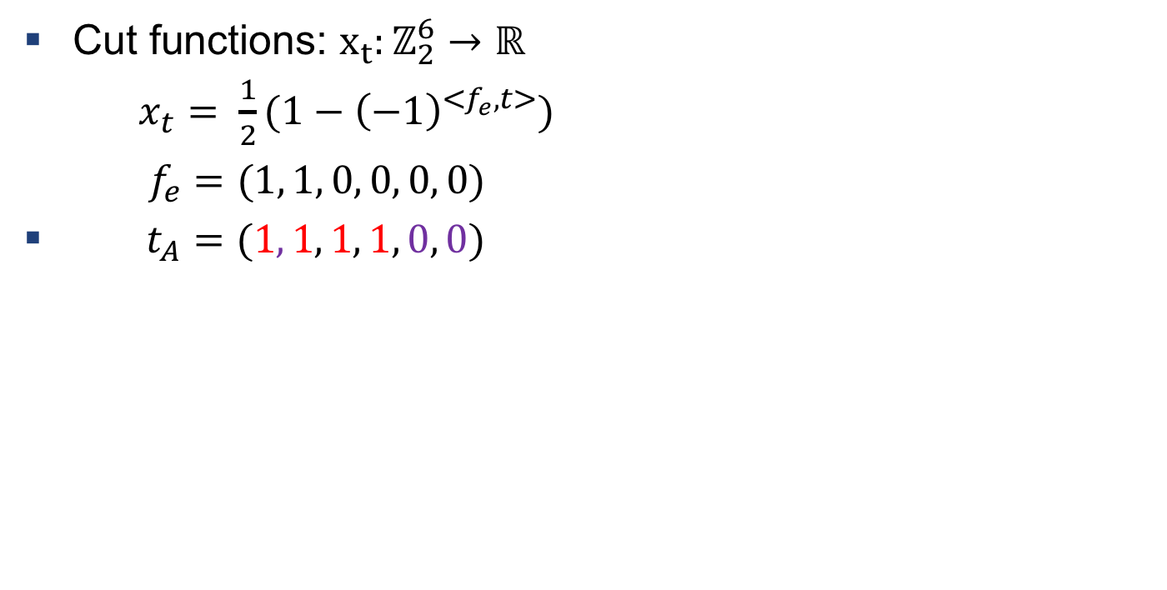
Examples: Cut functions
Cut functions: $x_{t}:ℤ_{2}^{6}→ℝ$
$x_{t}= \frac{1}{2}(1−{\left(−1\right)}^{<f_{e},t>})$
$f_{e}=(1, 1, 0, 0, 0, 0)$
$t_{A}=(1, 1, 1, 1, 0, 0)$
1
6
$$e$$
2
4
5
3
$$A=\{1, 2, 3, 4\}$$
$$V\backslash A=\{5, 6\}$$

Slide 10


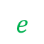
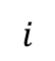
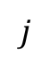
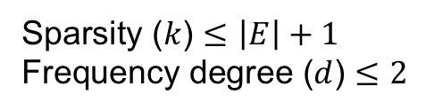
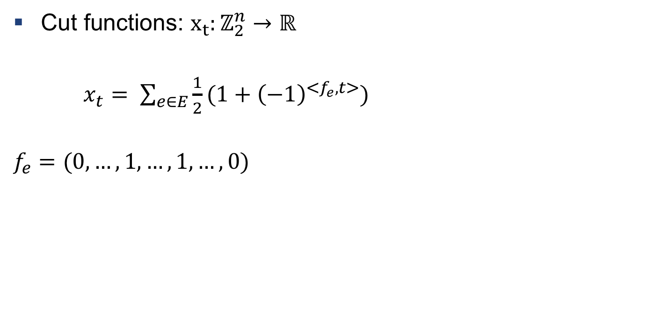
Examples: Cut functions
2
1
5
$$i$$
$$e$$
$$j$$
Cut functions: $x_{t}:ℤ_{2}^{n}→ℝ$
$x_{t}= \sum_{e∈E}{\frac{1}{2}(1+{\left(−1\right)}^{<f_{e},t>})}$
$$f_{e}=(0,…, 1, …,1, …, 0)$$
4
n
3
Sparsity ($k$) $≤\left|E\right|+1$
Frequency degree ($d$) $≤2$
$$i$$
$$j$$

Slide 11
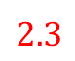


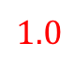
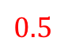
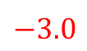
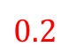
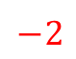



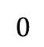

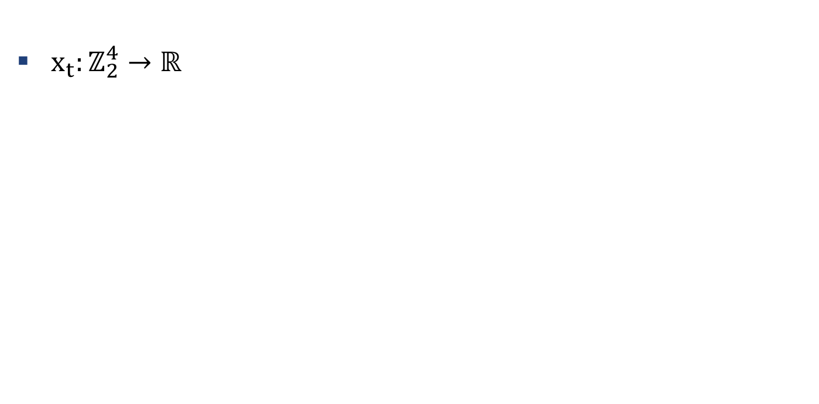





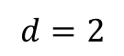
Examples: Decision trees
$${ t}_{1}$$
$$0$$
$$1$$
$x_{t}:ℤ_{2}^{4}→ℝ$
$${ t}_{2}$$
$${ t}_{3}$$
$$0$$
$$1$$
$$0$$
$$1$$
$$d=2$$
$$0.2$$
$$−2$$
$${ t}_{4}$$
$$t_{4}$$
$$0$$
$$0$$
$$1$$
$$2.3$$
$$1.0$$
$$0.5$$
$$−3.0$$

Slide 12
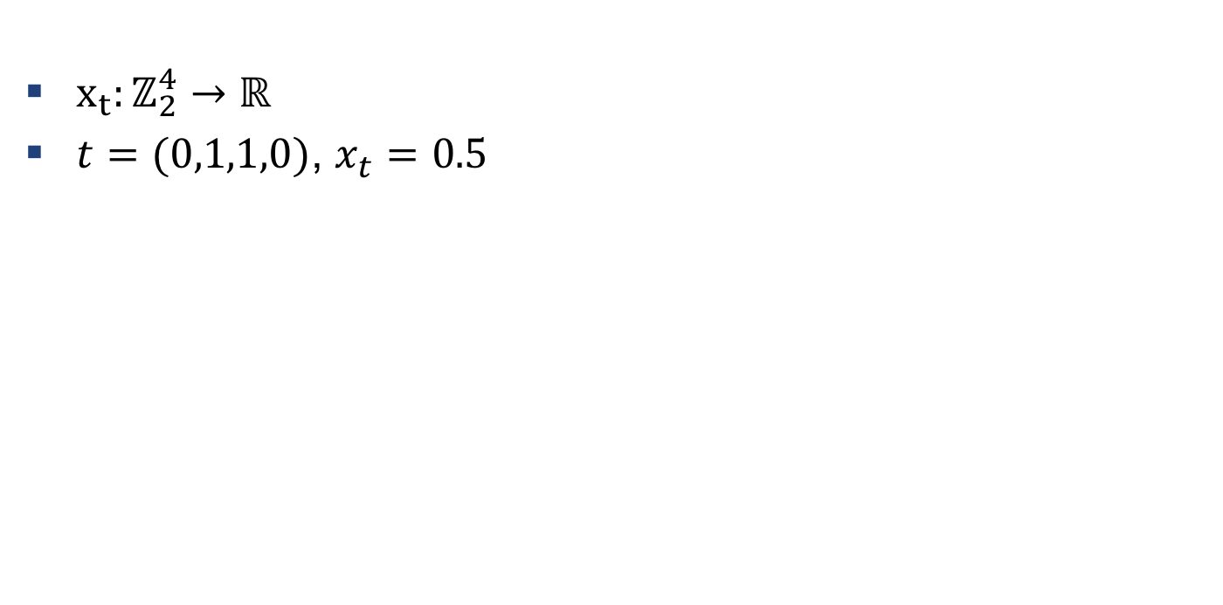
Examples: Decision trees
$${ t}_{1}$$
$$0$$
$$1$$
$x_{t}:ℤ_{2}^{4}→ℝ$
$t=(0,1,1,0)$, $x_{t}=0.5$
$${ t}_{2}$$
$${ t}_{3}$$
$$0$$
$$1$$
$$0$$
$$1$$
$$d=2$$
$$0.2$$
$$−2$$
$${ t}_{4}$$
$$t_{4}$$
$$0$$
$$0$$
$$1$$
$$2.3$$
$$1.0$$
$$0.5$$
$$−3.0$$

Slide 13
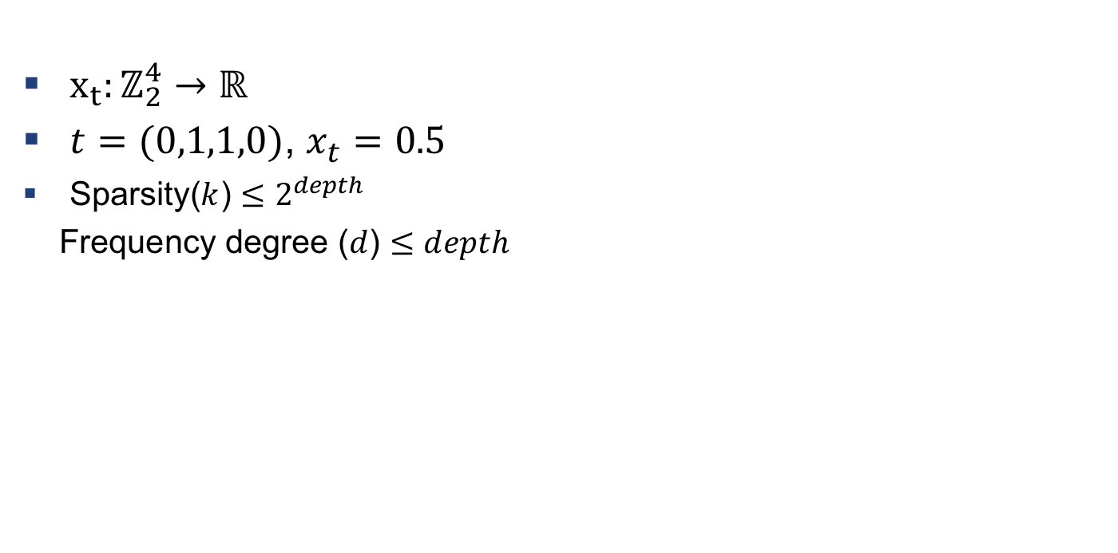
Examples: Decision trees
$${ t}_{1}$$
$$0$$
$$1$$
$x_{t}:ℤ_{2}^{4}→ℝ$
$t=(0,1,1,0)$, $x_{t}=0.5$
Sparsity($k$) $≤2^{depth}$
Frequency degree ($d$) $≤depth$
$${ t}_{2}$$
$${ t}_{3}$$
$$0$$
$$1$$
$$0$$
$$1$$
$$d=2$$
$$0.2$$
$$−2$$
$${ t}_{4}$$
$$t_{4}$$
$$0$$
$$0$$
$$1$$
$$2.3$$
$$1.0$$
$$0.5$$
$$−3.0$$

Slide 14
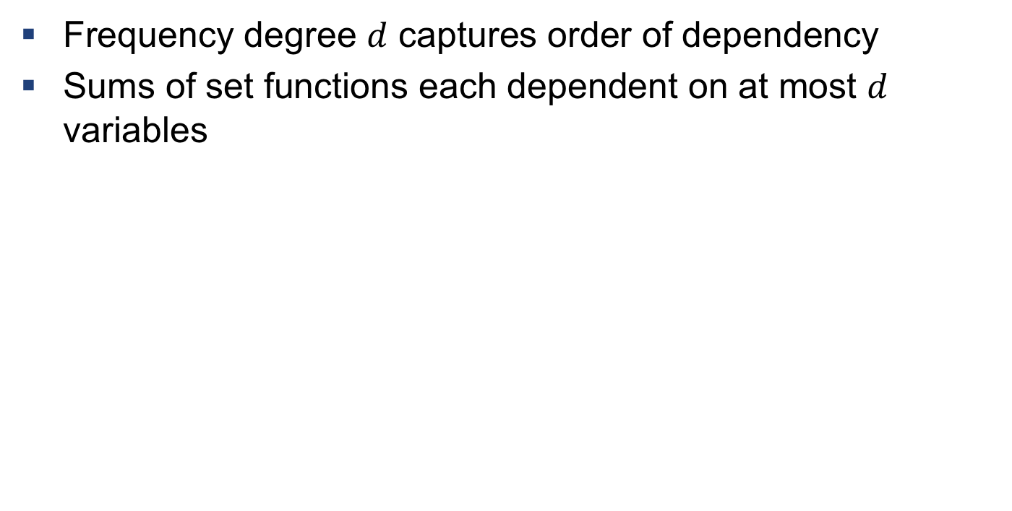
Examples: Other
Frequency degree $d$ captures order of dependency
Sums of set functions each dependent on at most $d$ variables

Slide 15
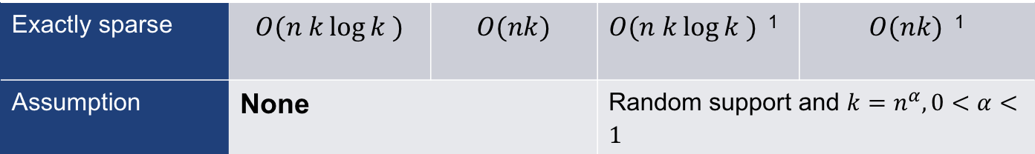
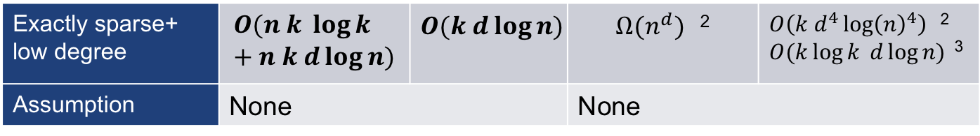
Results: exactly sparse
Our results
Previous results
Computation | Samples | Computation | Samples
Exactly sparse | $$O(n k\log{k )}$$ | $$O(nk)$$ | $O(n k\log{k )}$ ¹ | $O(nk)$ ¹
Assumption | None |  | Random support and $k=n^{α}, 0<α<1$
Exactly sparse+ low degree | $$O(n k \log{k }+n k d\log{n})$$ | $$O(k d\log{n})$$ | $Ω(n^{d})$ ² | $O\left(k d^{4}\log{{\left(n\right)}^{4}}\right)$ ² $O(k\log{k }d\log{n})$ ³
Assumption | None |  | None
¹: R. Scheibler et al. , "A Fast Hadamard Transform for Signals With Sublinear Sparsity in the Transform Domain," in IEEE Transactions on Information Theory, 2015.
²: S. Peter, and A. Krause. "Learning Fourier sparse set functions." Artificial Intelligence and Statistics, 2012.
³: I. Haviv, and O. Regev. “The restricted isometry property of subsampled Fourier matrices”. Geometric Aspects of Functional Analysis, 2017

Slide 16
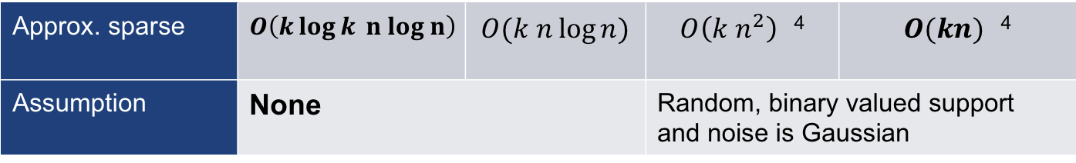
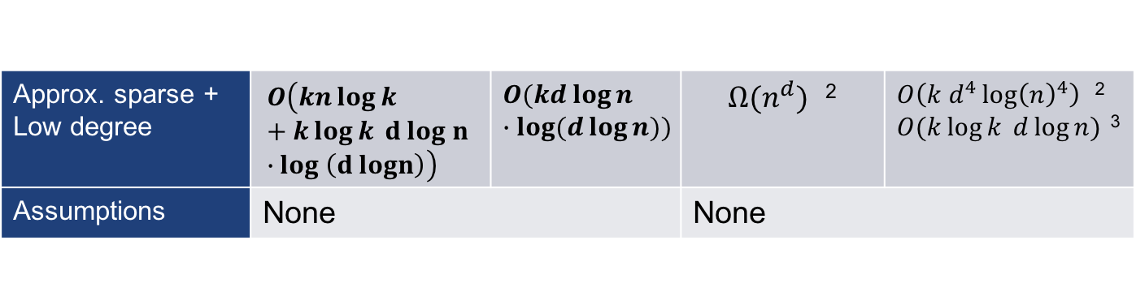
Results: approximately sparse
Our results
Previous results
Computation | Samples | Computation | Samples
Approx. sparse | $$O\left(k\log{k} n log n\right)$$ | $$O(k n\log{n})$$ | $O\left(k n^{2}\right)$ ⁴ | $O(kn)$ ⁴
Assumption | None |  | Random, binary valued support and noise is Gaussian
Approx. sparse + Low degree | $$O\left(kn\log{k}+k\log{k} d log n ∙log \left(d logn\right)\right)$$ | $$O(kd\log{n }∙\log{(d\log{n})})$$ | $Ω(n^{d})$ ² | $O\left(k d^{4}\log{{\left(n\right)}^{4}}\right)$ ² $O(k\log{k }d\log{n})$ ³
Assumptions | None |  | None
²: P. Sobbe, and A. Krause. "Learning Fourier sparse set functions." Artificial Intelligence and Statistics, 2012.
³: I. Haviv, and O. Regev. “The restricted isometry property of subsampled Fourier matrices”. Geometric Aspects of Functional Analysis, 2017
⁴:X. Li, J. K. Bradley, S. Pawar and K. Ramchandran, "The SPRIGHT algorithm for robust sparse Hadamard Transforms," IEEE International Symposium on Information Theory, 2014.

Slide 17
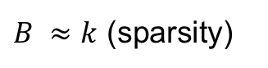
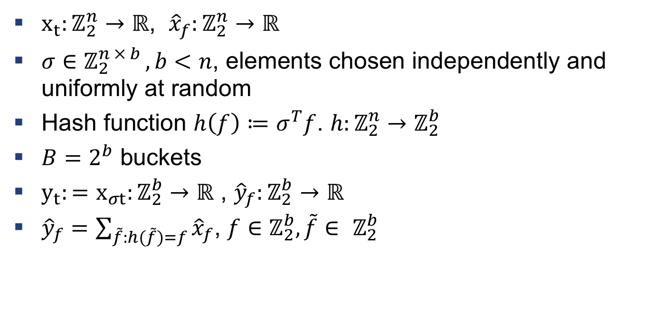
Techniques: hashing
$x_{t}:ℤ_{2}^{n}→ℝ$, ${\hat{x}}_{f}:ℤ_{2}^{n}→ℝ$
$σ∈$ $ℤ_{2}^{n × b }, b<n$, elements chosen independently and uniformly at random
Hash function $h\left(f\right)≔σ^{T}f$. $h:ℤ_{2}^{n}→ℤ_{2}^{b}$
$B=2^{b}$ buckets
${y_{t}:=x}_{σt}:ℤ_{2}^{b}→ℝ$ , ${\hat{y}}_{f}:ℤ_{2}^{b}→ℝ$
${\hat{y}}_{f}=\sum_{\tilde{f}:h(\tilde{f})=f}{{\hat{x}}_{f}}$, $f∈$ $ℤ_{2}^{b},\tilde{f}∈ ℤ_{2}^{b}$
Pairwise independent
$B ≈k$ (sparsity)

Slide 18
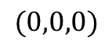
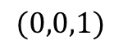

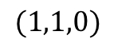
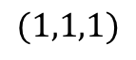
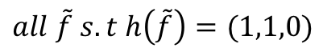
Techniques: hashing
$${\hat{y}}_{(1,1,0)}={\hat{x}}_{(1, 0, 0, 0, 0)}+{\hat{x}}_{(1, 1, 0, 0, 0)}+{\hat{x}}_{(1, 0, 1, 1, 0)}$$
$$all \tilde{f} s. t h\left(\tilde{f}\right)=(1,1,0)$$
$$(0,0,0)$$
$$(0,0,1)$$
$$…$$
$$(1,1,0)$$
$$(1,1,1)$$

Slide 19
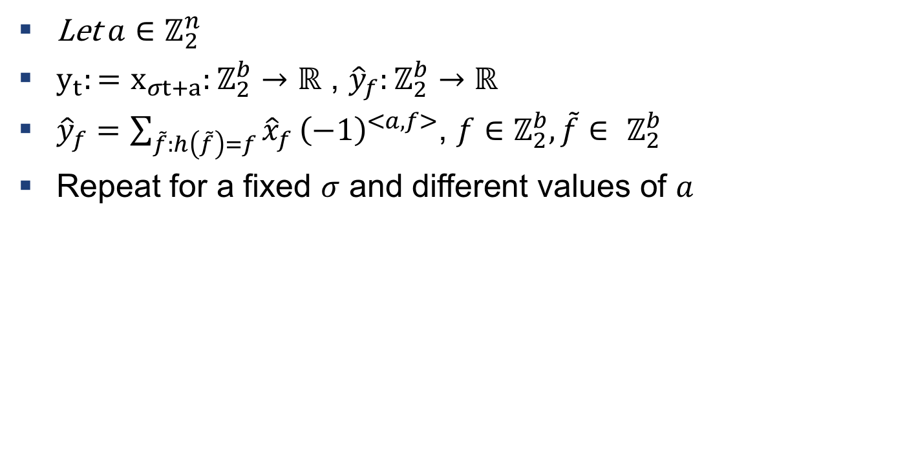
Techniques: hashing
Let $a∈ℤ_{2}^{n}$
${y_{t}:=x}_{σt+a}:ℤ_{2}^{b}→ℝ$ , ${\hat{y}}_{f}:ℤ_{2}^{b}→ℝ$
${\hat{y}}_{f}=\sum_{\tilde{f}:h\left(\tilde{f}\right)=f}{{\hat{x}}_{f}}{\left(−1\right)}^{<a,f>}$, $f∈$ $ℤ_{2}^{b},\tilde{f}∈ ℤ_{2}^{b}$
Repeat for a fixed $σ$ and different values of $a$

Slide 20
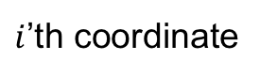


Techniques: Compressive Sensing over finite fields
Given linear measurements of type $<a_{i}, f>$ can one recover $f$ ?
Just set $a_{i}=e_{i}=(0,…0 , 1, 0, …,0)$ for $i∈[n]$
What if frequency is of degree one ?
Binary search: $O\left(\log{n}\right)$ measurements
What if frequency is of degree $d$ ?
Hashing and binary search: $O\left(d\log{n}\right)$ measurements
$$f=$$
0
0
0
1
0
0
0
0
$i$’th coordinate
0
1
0
1
0
1
0
1
0
1
0
1
0
1

Slide 21






Techniques: peeling
What if there are collisions?
$${\hat{x}}_{f_{1}}$$
$${\hat{x}}_{f_{2}}$$
$${\hat{x}}_{f_{3}}$$
$${\hat{x}}_{f_{4}}$$
$${\hat{x}}_{f_{5}}$$
$${\hat{x}}_{f_{6}}$$

Slide 22






Techniques: peeling
What if there are collisions?
$${\hat{x}}_{f_{1}}$$
$${\hat{x}}_{f_{2}}$$
$${\hat{x}}_{f_{3}}$$
$${\hat{x}}_{f_{4}}$$
$${\hat{x}}_{f_{5}}$$
$${\hat{x}}_{f_{6}}$$

Slide 23

















Techniques: peeling
What if there are collisions?
$${\hat{x}}_{f_{1}}$$
$${\hat{x}}_{f_{2}}$$
$${\hat{x}}_{f_{3}}$$
$${\hat{x}}_{f_{4}}$$
$${\hat{x}}_{f_{5}}$$
$${\hat{x}}_{f_{6}}$$
$$−$$
$${\hat{x}}_{f_{1}}$$
$${\hat{x}}_{f_{2}}$$
$${\hat{x}}_{f_{3}^{′}}$$
$${\hat{x}}_{f_{4}^{′}}$$
$${\hat{x}}_{f_{5}}$$
$${\hat{x}}_{f_{6}}$$
$${\hat{x}}_{f_{2}}$$
$${\hat{x}}_{f_{3}}$$
$${\hat{x}}_{f_{2}^{′}}$$
$${\hat{x}}_{f_{3}^{′}}$$

Slide 24




Experiments

Slide 25

Experiments

